Slide 1
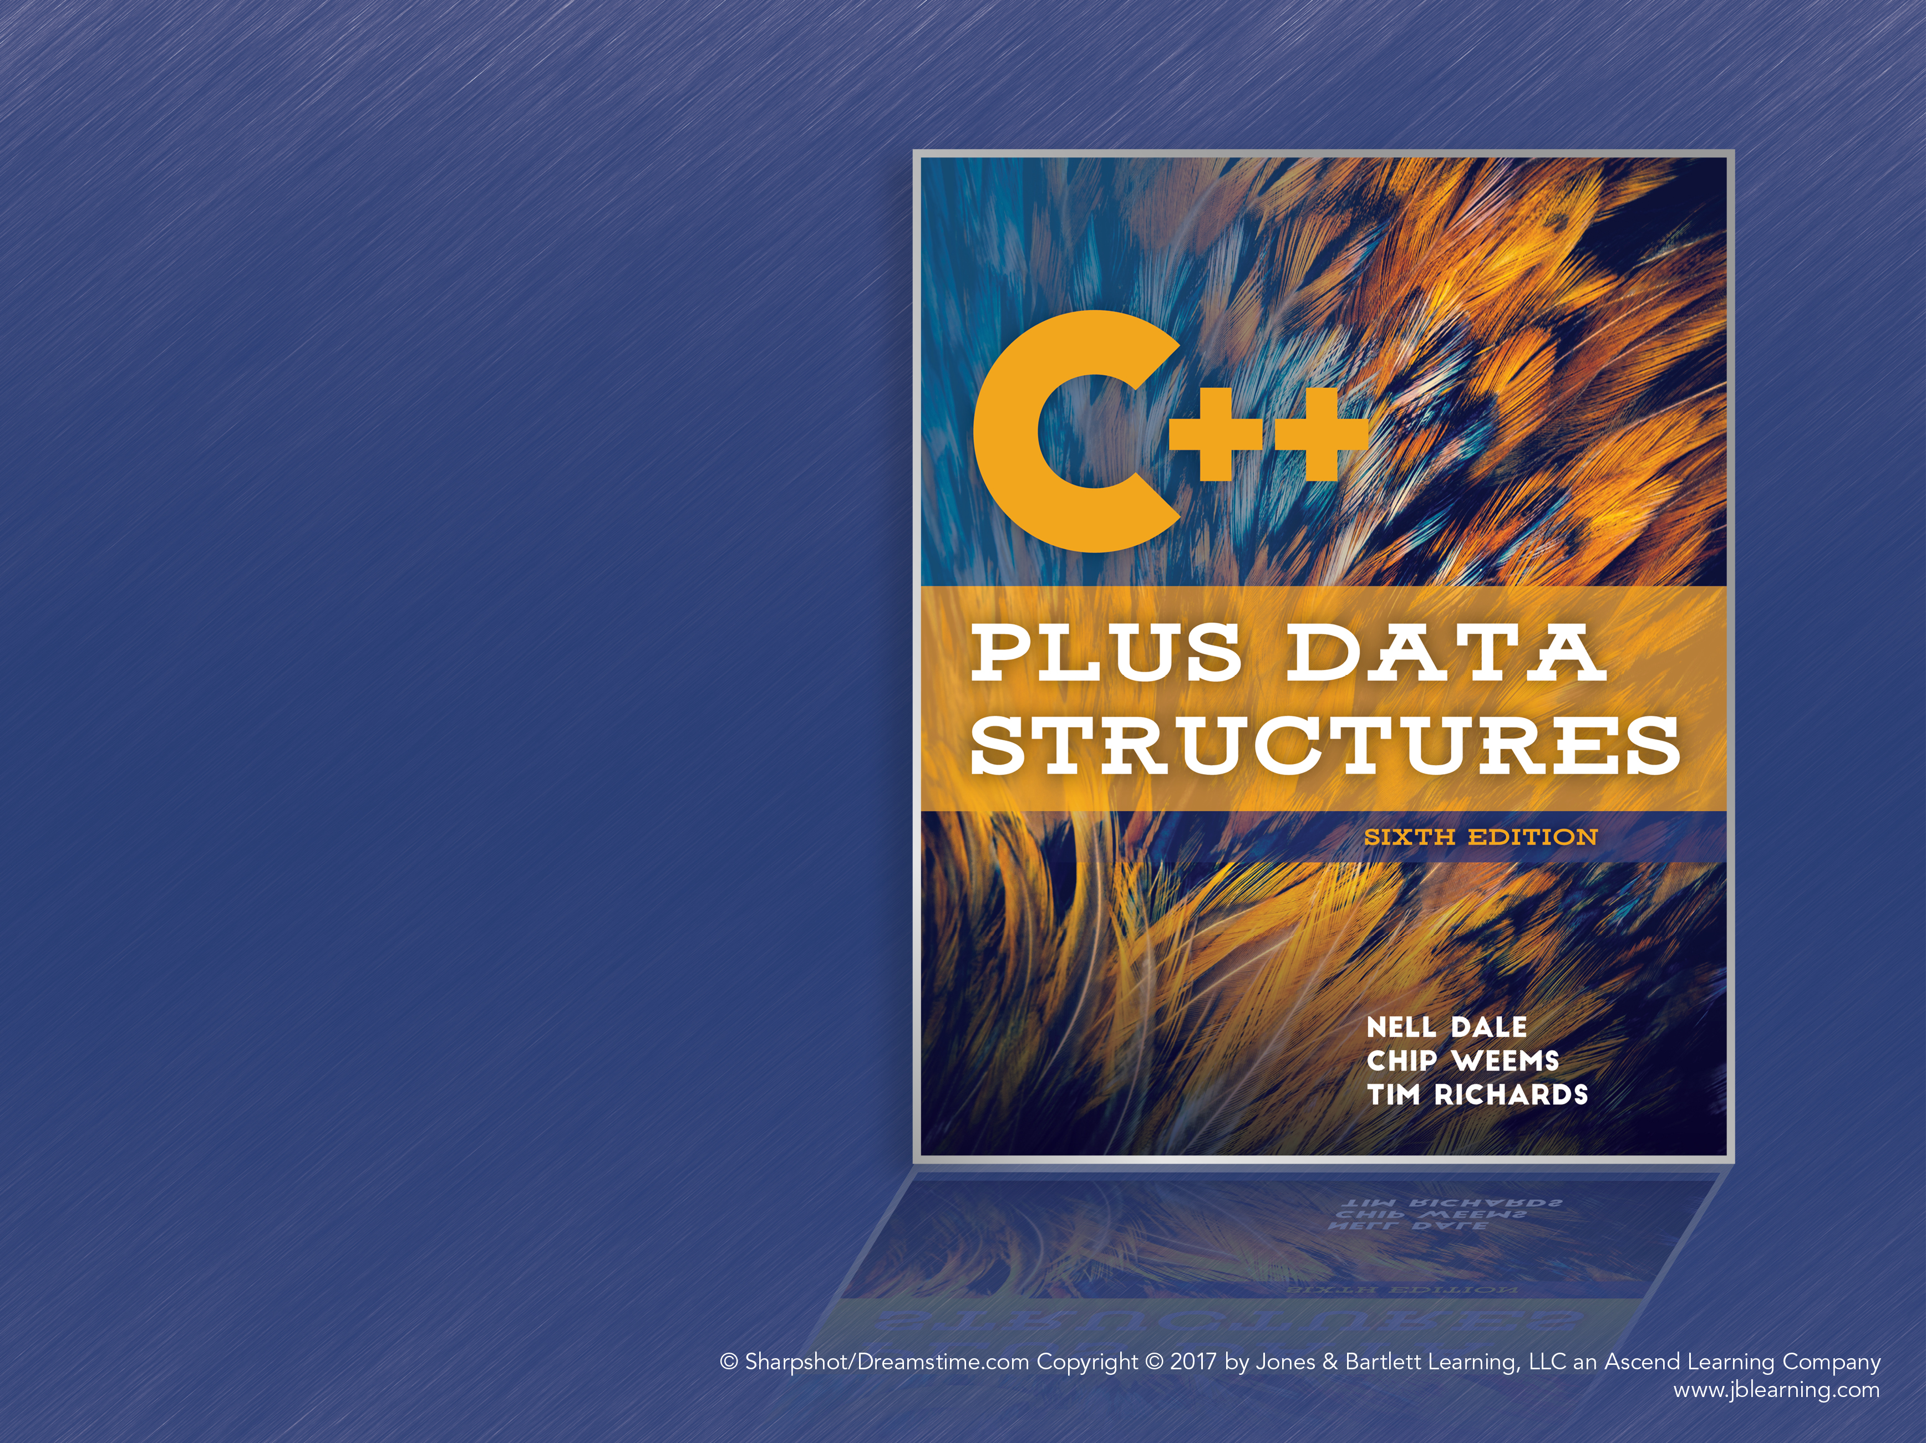
Chapter 5
ADTs Stack and Queue
Notes:
1

Slide 2
Stacks: Logical Level
Stack: An ADT where items are added and removed only from the top of the structure; this behavior is called LIFO (Last In, First Out)
Items are “ordered” by when they were added to the stack
Like lists, stacks store homogeneous items

Slide 3
Stack Operations
Push: Adds an item to the top of the stack
Pop: Removes the top item from the stack
Top: Returns the item at the top of the stack but does not remove it
IsEmpty: Returns true if the stack has no items
IsFull: Stacks are logically unbounded, but implementations may be bounded

Slide 4
Stacks: Application Level
Stacks have many applications in software engineering. Some examples:
Tracking the function calls in a program
Performing syntax analysis on a program
Traversing structures like trees and graphs
Some programming languages are entirely stack-based, such as Forth

Slide 5
Stacks: Implementation Level
Since elements are homogeneous, an array-based approach can be used
Elements are inserted into subsequent indices in the array
Very similar to the Unsorted List ADT!
We can use the same implementation strategy, but keep in mind: A stack is not the same as an unsorted list

Slide 6
Stack Operation Implementation
The top field is the index of the top of the stack
Push: Increment top and insert the element at the index given by top
If the array is full, attempting to add an item triggers stack overflow and an exception is thrown
IsEmpty: top == -1
IsFull: top == MAX_ITEMS – 1
Push increments top before adding an item, so top is set back one from the start

Slide 7
Stack Operation Implementation (cont.)
Pop: The opposite of Push; simply decrement top, treating the removed item as garbage
Top: Returns items[top]; if the stack is empty, triggers stack underflow
What if the stack is empty? Calling Pop or Top on an empty stack triggers stack underflow and an exception is thrown

Slide 8
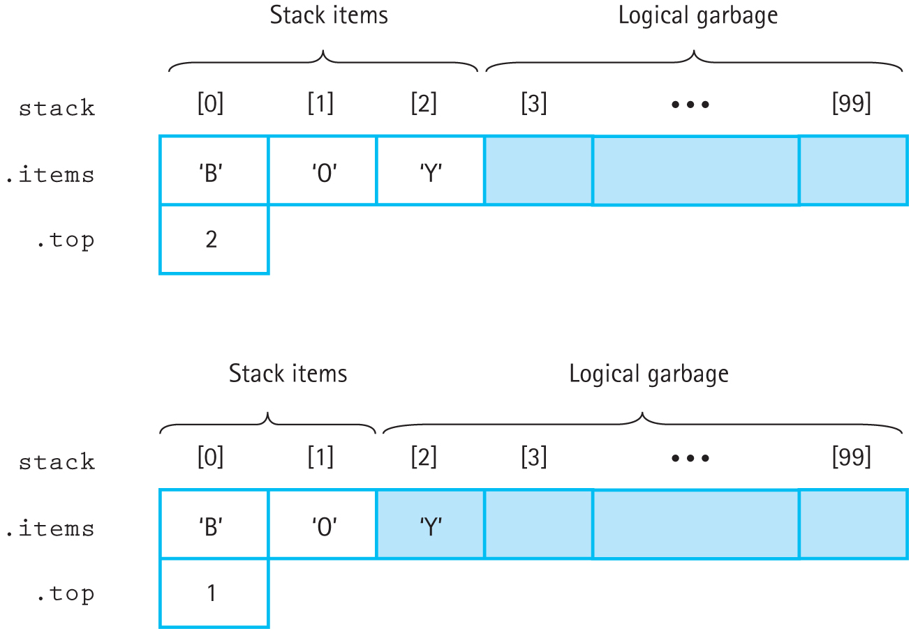
Stacks: Push and Pop
Figure 5.4 The effect of a Pop following a series of Pushes

Slide 9
Dynamic Array Implementation
As with lists, we can implement the stack with a dynamically allocated array
Add parameterized and default constructors
Add a destructor to clean up the array
Replace references to MAX_ITEMS with maxStack, which is now a field in the class

Slide 10
Linked List-Based Stack
Linked Lists allow our stack to be physically unbounded (or only bounded by memory)
The main change to the class definition is adding a pointer to the top element
This gives us direct access to the top of the stack

Slide 11
Linked-List Implementation: Push
Essentially the same as Unsorted List
Create a new node for the new element
Have it point to topPtr as its next element
Update topPtr to point to the new node
Additionally, must throw an exception if the stack is full when Push is called

Slide 12
Linked-List Implementation: Pop
The algorithm is simple:
Make a tempPtr that copies topPtr
Update topPtr to point to the next node on the stack
Delete the node pointed to by tempPtr
If the stack is empty when Pop is called, an exception should be thrown

Slide 13
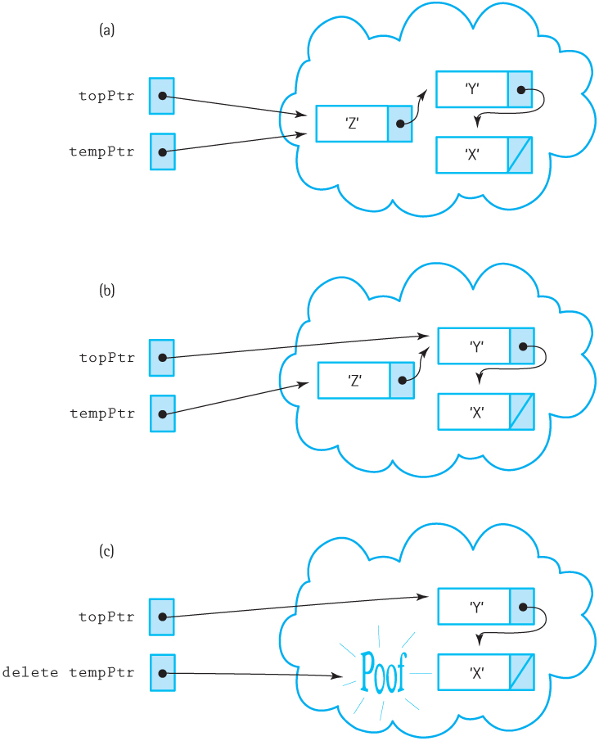
Linked-List Implementation: Pop (cont.)
Figure 5.5 Popping the stack

Slide 14
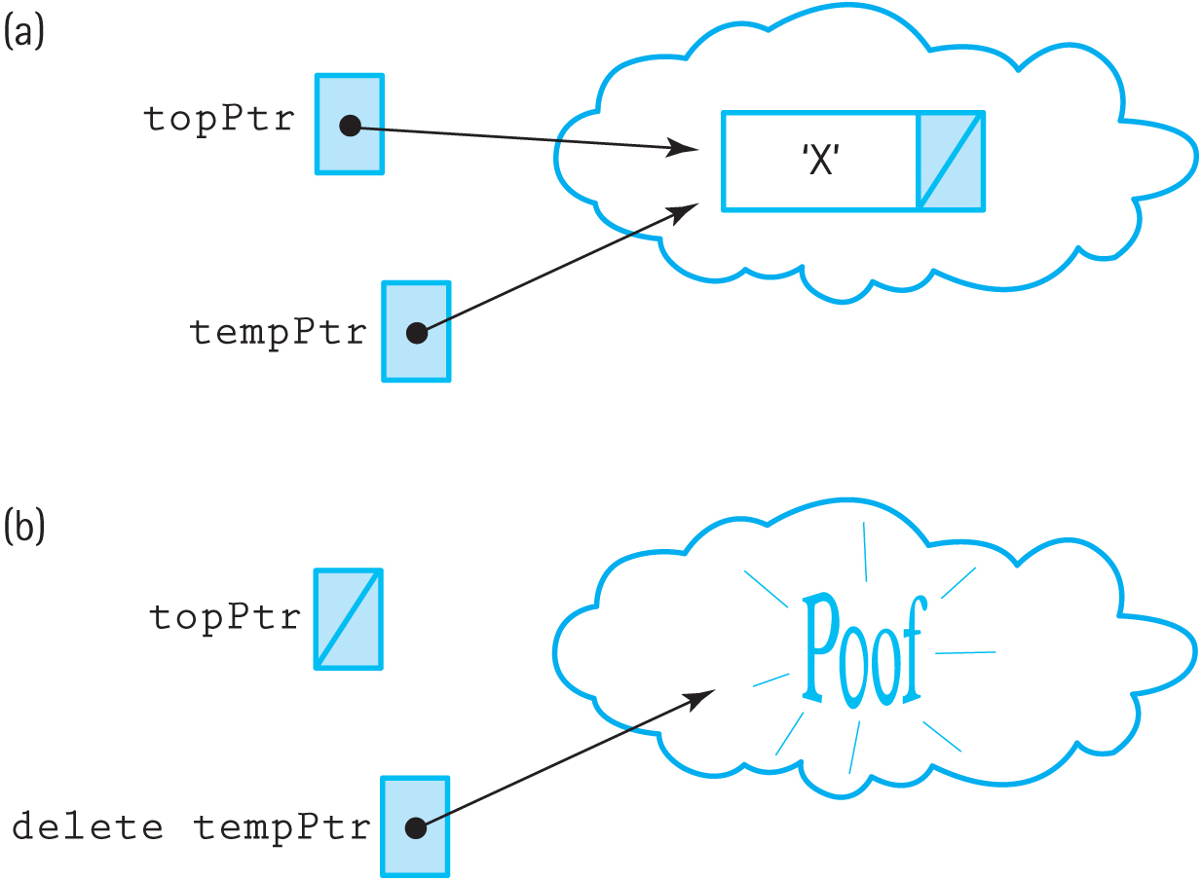
Popping the Last Stack Element
The algorithm correctly handles removing the last element of the stack
Figure 5.6 Popping the last element on the stack

Slide 15
Other Stack Functions
Top: Returns topPtr->info
IsEmpty: Returns topPtr == NULL
IsFull: Attempts to allocate a new node, using a try-catch block to handle the bad_alloc exception; if an exception is thrown, returns true
Constructor: Initializes topPtr to NULL
Destructor: Walks the stack and deallocates every node

Slide 16
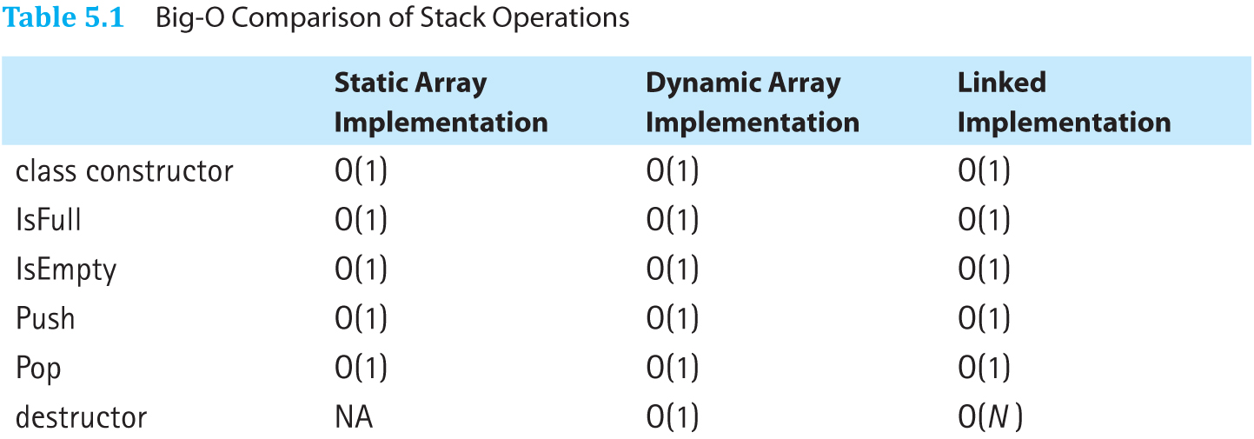
Comparing Stack Implementations
Table 5.1 Big-O Comparison of Stack Operations

Slide 17
Comparing Stack Implementations (cont.)
Array-based version is small, simple, and efficient
May allocate too much memory (stack size small)
May not have enough memory (stack size large)
Linked list-based version is very flexible and more memory efficient
Only allocates memory as needed
Some operations have higher overhead

Slide 18
Queues: Logical Level
Queue: An ADT in which elements are added to the rear and removed from the front; this behavior is called FIFO (First In, First Out)
Items are homogeneous, like in stacks and lists
Example: A line of people at a cash register

Slide 19
Queue Operations
Enqueue: Add an item to the end of the queue
Dequeue: Removes the item at the front of the queue and returns it
IsEmpty: Returns true if the queue is empty
IsFull: Returns true if the queue is full
MakeEmpty: Removes all items from the queue

Slide 20
Queues: Application Level
Like stacks, queues are used in various ways by the OS and other systems:
Scheduling jobs on the processor
Buffering data between processes or other systems

Slide 21
Queues: Implementation Level
Several implementations are possible
As before, we’ll start with an array-based implementation

Slide 22
Fixed-Front Queue
Array-based implementation where index 0 is always the front of the queue
Enqueue fills in the first empty slot
Dequeue empties the first slot and moves all subsequent elements up
Copying elements like this is inefficient

Slide 23
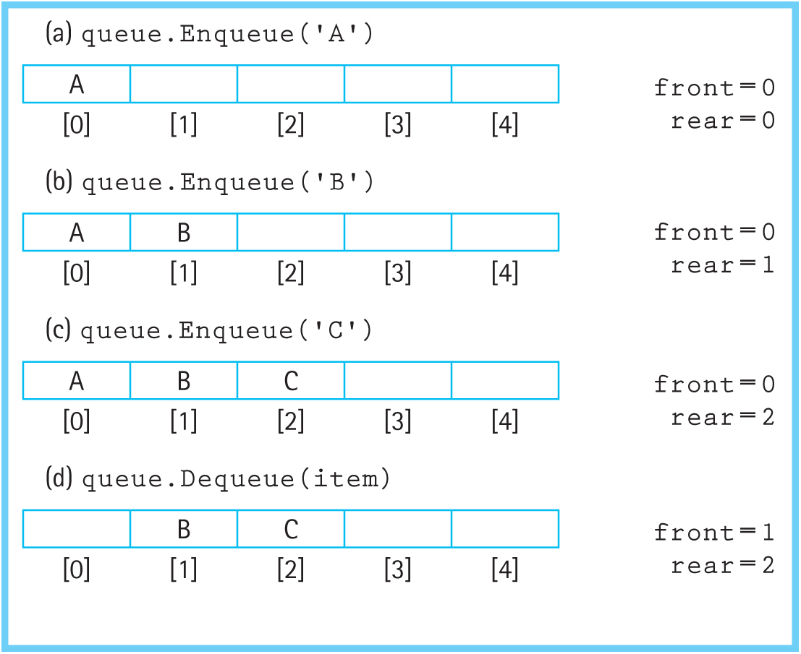
Floating Queue
Both the front and end of the queue float in the array
Figure 5.9 The effect of Enqueue and Dequeue

Slide 24
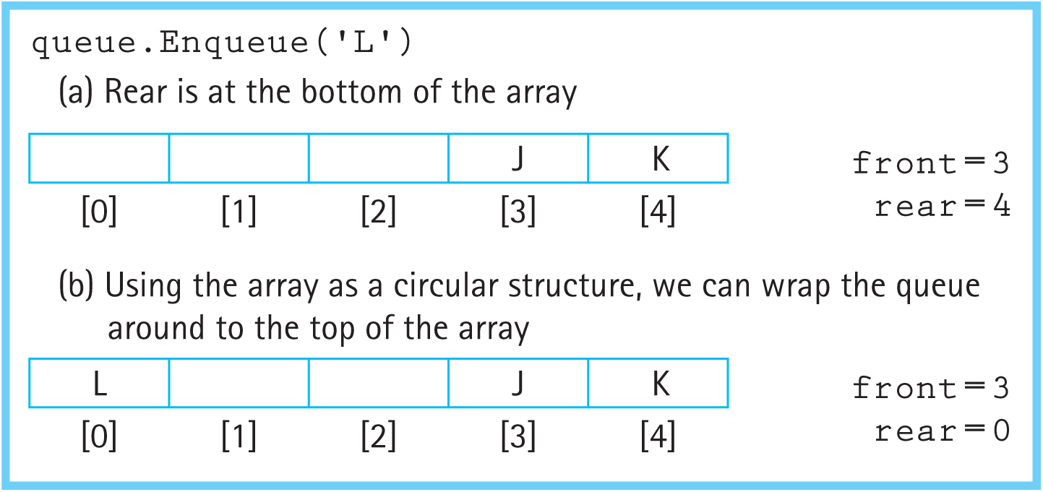
Floating Queue
What happens when we reach the end of the array but the queue isn’t full?
We treat the array as a circular structure by using rear = (rear + 1) % maxQue:
Figure 5.10 Wrapping the queue elements around

Slide 25
Floating Queue: IsFull and IsEmpty
How do we know if the queue is empty or full?
One approach: Keep track of the number of elements in the queue
Another approach: Make front point to the space before the actual first element
If front == rear, the queue is empty
The space indicated by front is reserved

Slide 26
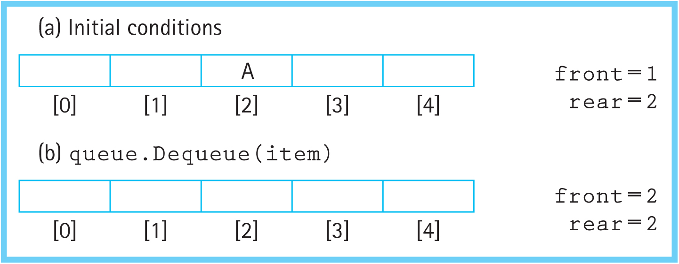
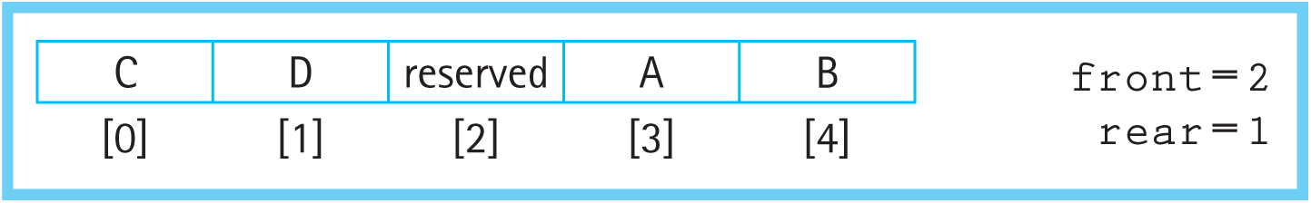
Floating Queue: IsFull and IsEmpty (cont.)
Figure 5.13 Testing for an empty queue
Figure 5.14 Testing for a full queue

Slide 27
Comparing Array Implementations
The fixed-front queue has a less efficient Dequeue implementation
The floating circular queue is more complex but has a more efficient Dequeue
All other operations are O(1)

Slide 28
Counted Queue
Users may want a count of items in the queue
Instead of making an entirely new class, we’ll instead derive CountedQueType from QueType
Logically, it needs a field for the count, a method to return the count, a new constructor that initializes the count to 0, and slightly modified Enqueue and Dequeue that change the count
Deriving the class lets us avoid most of the work

Slide 29
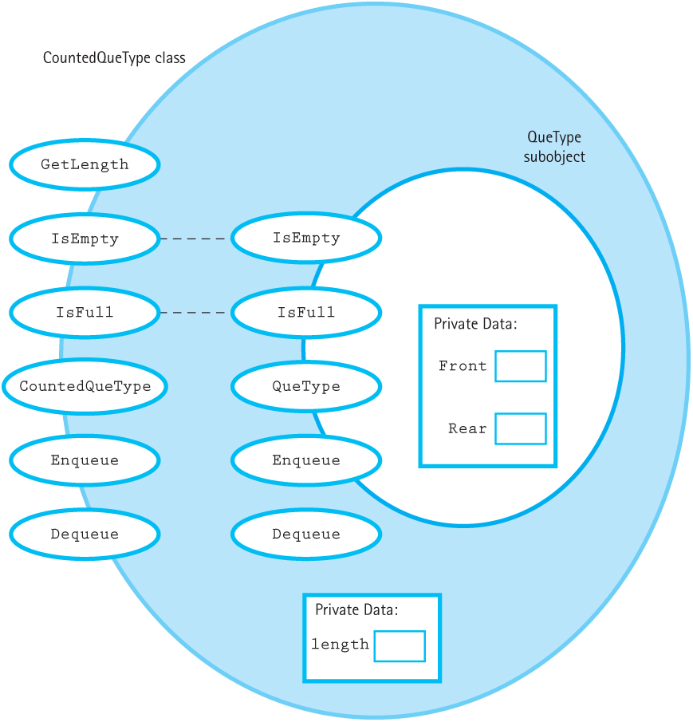
Counted Queue Class Diagram
Figure 5.15 Class interface diagram for CountedQueType class

Slide 30
Inheritance
CountedQueType is the derived class or subclass
QueType is the base class or superclass
CountedQueType can’t access QueType’s private members, but can call the public methods

Slide 31
Queue Inheritance
CountedQueType’s Enqueue and Dequeue call QueType’s methods and then modify length
CountedQueType uses QueType’s IsFull and IsEmpty method instead of writing new ones

Slide 32
Linked-List Based Queues
Conceptually similar to the circular queue
Keep two pointers, tracking the front and rear of the queue

Slide 33
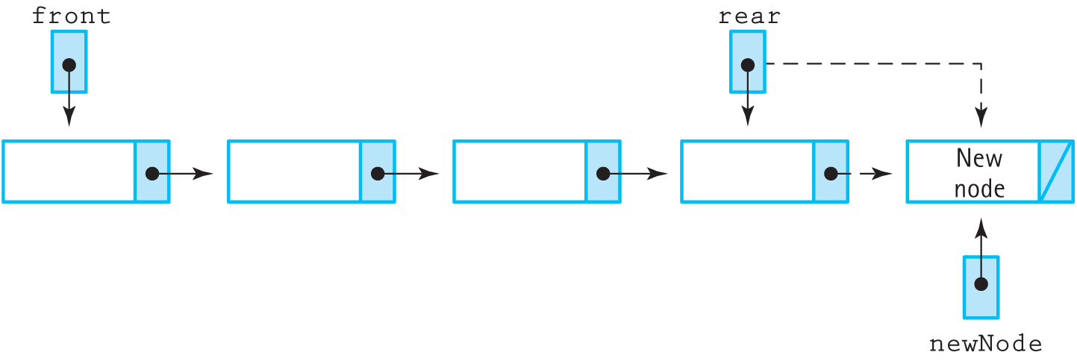
Linked-List Queue: Enqueue
Algorithm:
Allocated new node
Update rear->next to point to new node
Update rear to point to new node
If queue was empty, also update front
Figure 5.17 The Enqueue operation

Slide 34
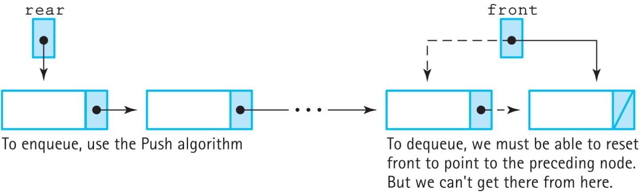
Alternate Enqueue
Could try to implement Enqueue the same as the stack’s Push by reversing the rear and front pointers
But this makes Dequeue impossible to implement because we can’t go back up the queue
Figure 5.18 A bad queue design

Slide 35
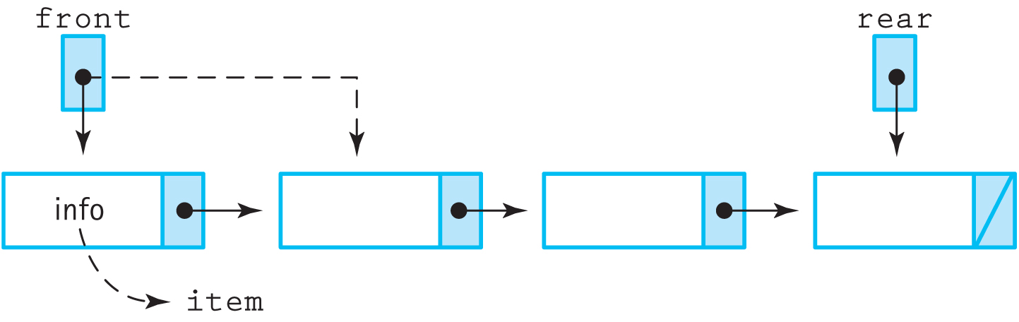
Linked-List Queue: Dequeue
Similar to the linked list stack’s Pop:
Use a temp pointer to track the front item
Advance the front pointer to front->next
If front is now NULL, set rear to NULL (queue is empty)
Figure 5.19 The Dequeue operation

Slide 36
Other Queue Operations
IsFull: Attempts to allocate a new node
IsEmpty: Checks if front is NULL
MakeEmpty: Walks the linked structure and deallocates the nodes
Destructor: Calls MakeEmpty

Slide 37
Circular Linked Queue
Is it possible to have only one pointer in the QueType class?
Only front: Can access the rear by walking the links, which is O(N)
Only rear: Can’t access the front because the links only point towards the rear
Yes, by implementing a circular linked list

Slide 38
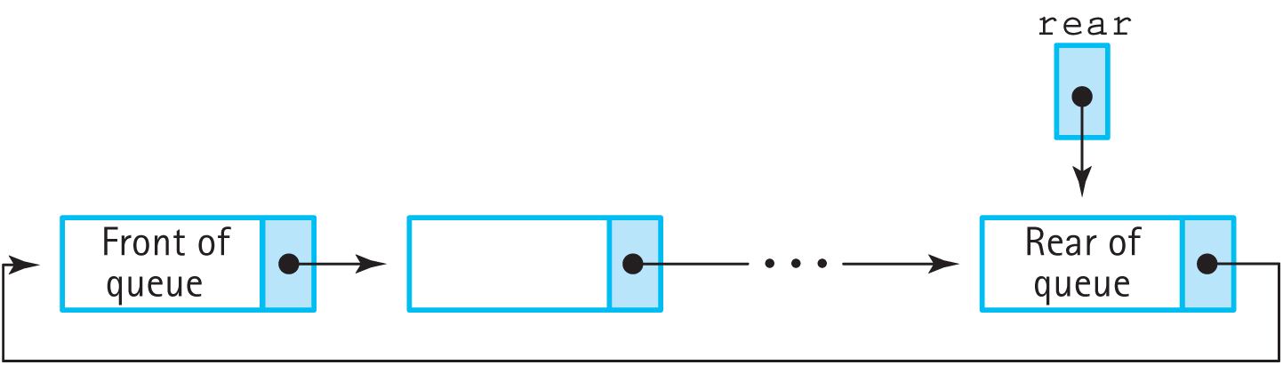
Circular Linked Queue
The class only has a pointer to the rear of the queue
Instead of pointing to NULL, the last node’s next points to the front of the queue
Figure 5.20 A circular linked queue

Slide 39
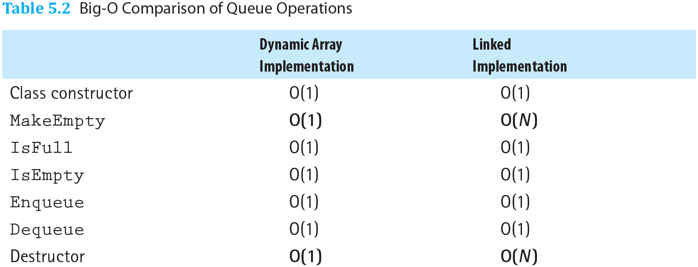
Comparing Queue Implementations
All operations are O(1), except the linked list-based MakeEmpty and destructor are O(N)
The linked list-based queue has memory overhead
Table 5.2 Big-O Comparison of Queue Operations

Slide 40
Comparing Queue Implementations
The array-based queue requires a fixed amount of memory no matter how many items are actually in the queue
The linked list-based queue consumes more memory as more elements are added
For cases with few items or large items, linked list-based queues can be more efficient

Slide 41
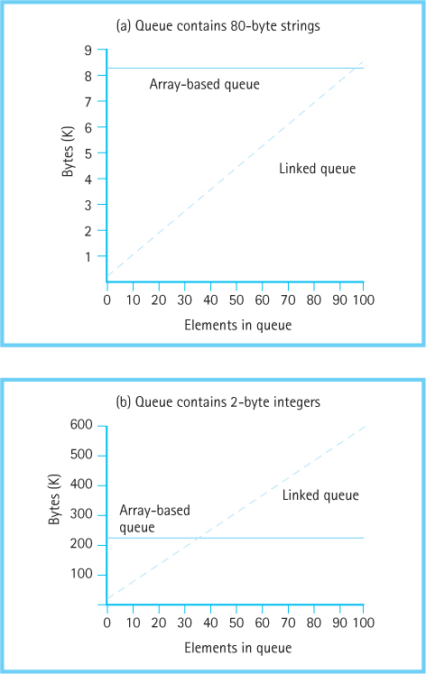
Array vs. Linked-List Memory
Figure 5.21 Comparison of storage requirements: (a) Queue contains 80-byte strings
(b) Queue contains 2-byte integers

